Slide 1
Predicting Football Game Outcomes
A Comparison of Classification Algorithms
Blue Team:
Pranay Charan Kolasani
Ankit Koul
Hari Krishna Thallapally
Presentation for SCH-MGMT690STG

Slide 2


Objective
Analyze and test machine learning techniques on a dataset of Premier League matches, as that is the world’s most-watched league in soccer.
Create a model that can predict the outcome of the games that took place within the season.
Compare the Baseline model that can predict the outcome of the game using the halftime results with four different Machine Learning Models
Presentation for SCH-MGMT690STG

Slide 3
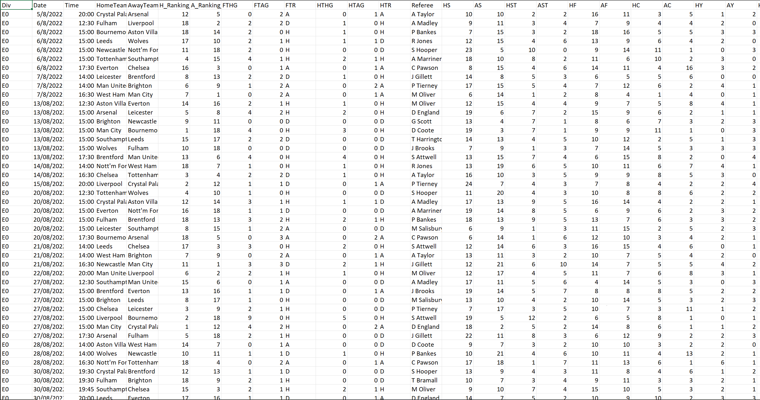

INPUT DATA
https://drive.google.com/file/d/1GPUuD3NnBxcSVlQfugH6Ov_fSb5Zfq3l/view?usp=drive_link
Glance at Input data:
Presentation for SCH-MGMT690STG

Slide 4
Data Preprocessing
Data Splitting
Model Selection
Model Training
Model Evaluation
Model Comparison
Process Workflow
Presentation for SCH-MGMT690STG

Slide 5
DATA PRE-PROCESSING
Steps Involved
Identify data types and non-null records
Identify unique values
Identify and Separate Categorical and Numerical data
Shortlist the most relevant factors that will impact the accuracy of the model
Separate Independent and Dependent columns
One Hot encode all categorical variables(Dummies Creation)
Split the data into test and train data
Create the Baseline Model
Exploratory Data Analysis
Presentation for SCH-MGMT690STG

Slide 6
Feature Engineering
Raw data initially had 108 columns
We picked 18 which we felt will affect the football game outcomes
Out of those 18 after EDA we identified 12 variables that will affect my final outcome “FTR”
H_Ranking_Prior_Season
A_Ranking_Prior_Season
HomeTeam
AwayTeam
HS
AS
HTHG
HTAG
B365H
B365A
B365D
half_time_GD
Presentation for SCH-MGMT690STG

Slide 7
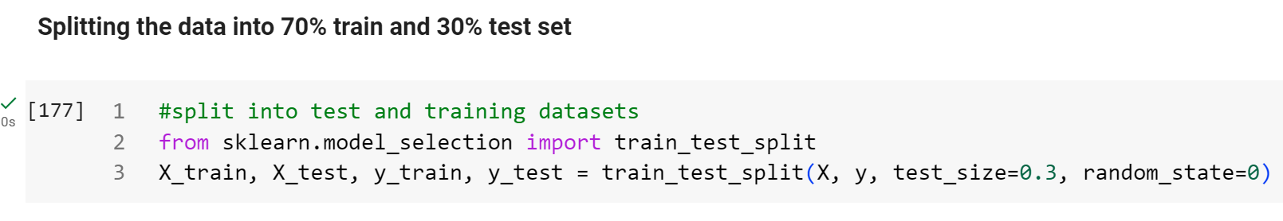
Data Splitting
Test-Train Separation:
Utilizing train_test_split divides the dataset into training and testing subsets, allowing model training on one portion and evaluation on another to assess generalization performance
Presentation for SCH-MGMT690STG

Slide 8
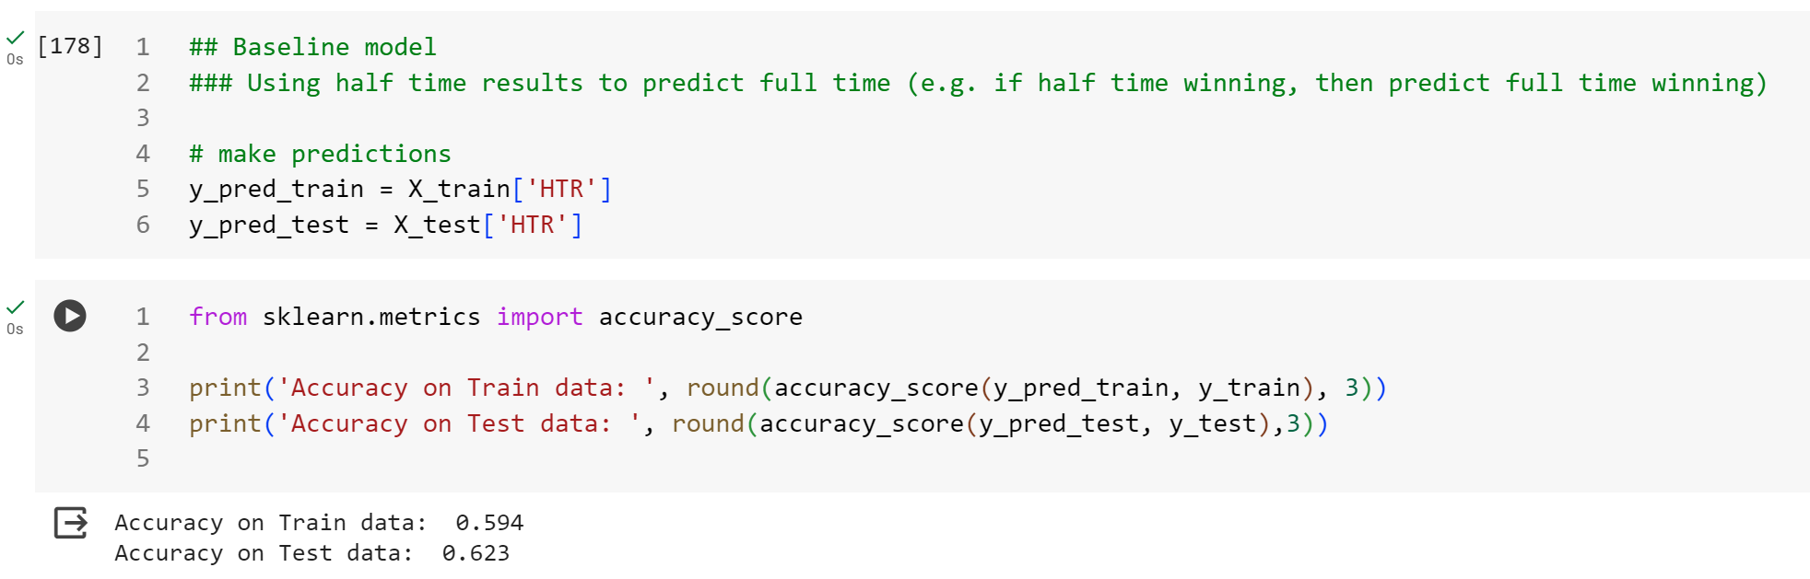
Baseline Model
Baseline model that can predict the outcome of the game using the halftime results.
Accuracy on Test data: 0.623
Presentation for SCH-MGMT690STG

Slide 9
Model Selection
Decision Tree: Decision Trees can capture non-linear relationships and interactions among all the variables, which is important in predicting match outcomes.
Logistic Regression: Logistic Regression is suitable for binary classification tasks, making it relevant for predicting match outcomes (e.g., Win or Loss).
KNN : KNN is based on the idea that similar instances have similar outcomes. This could be relevant in the context of Premier League matches where similar halftime results might lead to similar full-time outcomes.
Random Forest: Random Forests provide information on feature importance, helping you identify which variables contribute the most to the predictions.
Random Forests, as an ensemble of Decision Trees, can enhance predictive performance compared to individual trees. This could potentially lead to better accuracy in predicting match outcomes.
Presentation for SCH-MGMT690STG

Slide 10
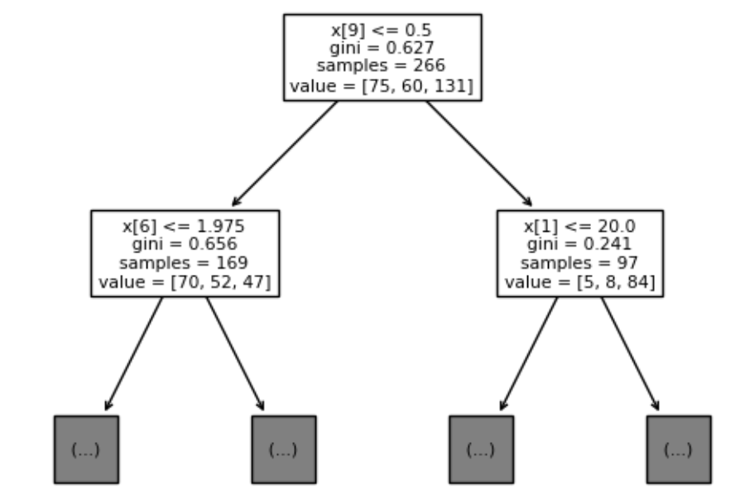
Results – Decision Tree
Tree accuracy on train set: 1.0
Tree accuracy on test set: 0.482
Upon observing the results, it becomes apparent that the model exhibits lower accuracy on the test dataset compared to the training dataset.
This discrepancy suggests potential overfitting, where the model performs well on the training data but struggles to generalize to new, unseen data.
To address this overfitting, we can employ hyperparameter tuning techniques.
Presentation for SCH-MGMT690STG

Slide 11
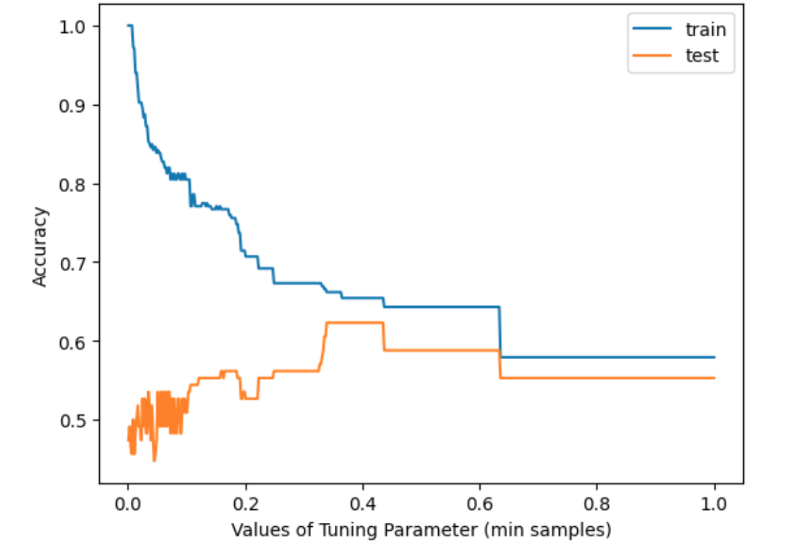
Hyperparameter Tuning on Decision Tree
Results after doing Hyperparameter tuning of Decision Tree:
Maximum test accuracy: 0.623
Value of min samples that achieves max test accuracy: 0.33934
The overall accuracy of the hyper-tuned tree model improved from 0.482 to 0.623. This indicates that the model is making more accurate predictions on the test dataset after hyperparameter tuning
Presentation for SCH-MGMT690STG

Slide 12
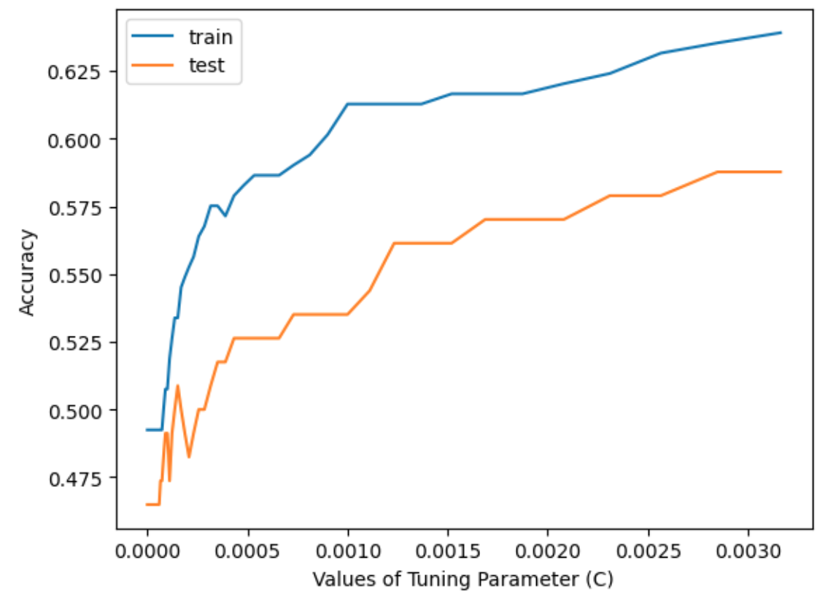
Results – Logistic Regression
Logistic regression accuracy on train set: 0.767
Logistic regression accuracy on test set: 0.579
Upon observing the results, it becomes apparent that the model exhibits lower accuracy on the test dataset compared to the training dataset.
Results after doing Hyperparameter tuning of Logistic Regression:
Maximum test accuracy: 0.588
Value of C that achieves max test accuracy: 0.00285
The overall accuracy of the hyper-tuned tree model improved from 0.579 to 0.588. Not much difference hyperparameter tuning is making for Logistic Regression
Presentation for SCH-MGMT690STG

Slide 13
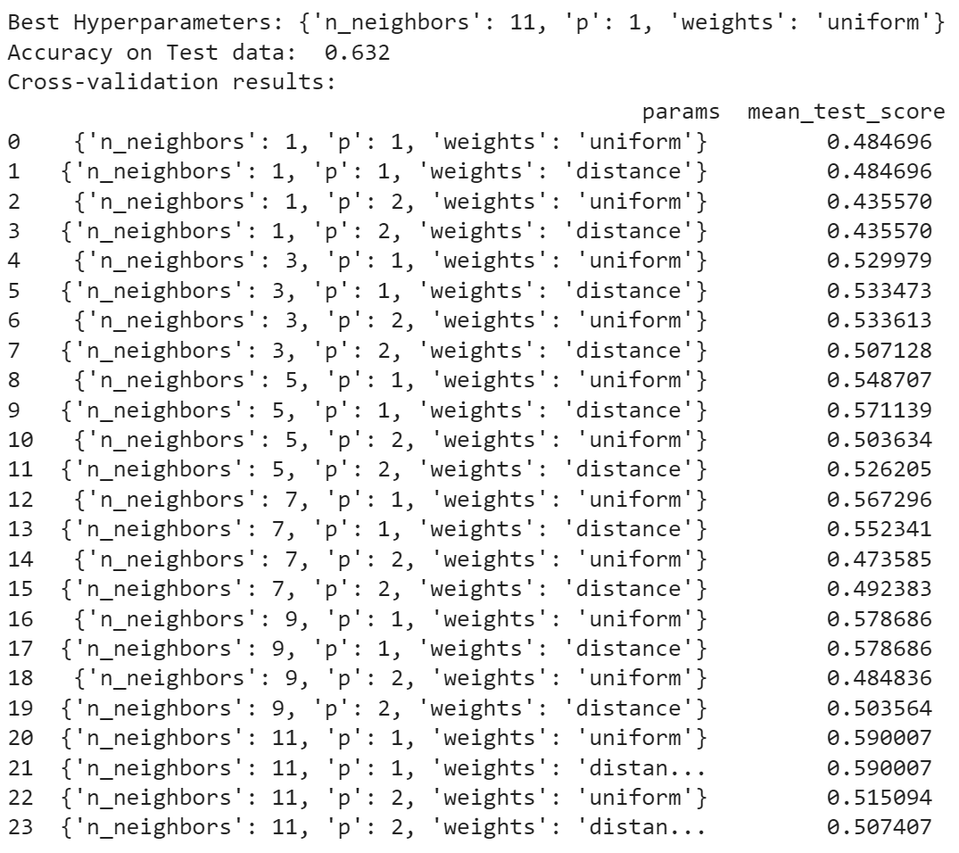
Results – KNN(K-Nearest Neighbor's)
Accuracy on Train data: 0.688
Accuracy on Test data: 0.509
Cross Validation on KNN:
Cross-validation allows you to train and evaluate the model multiple times using different subsets of the data, providing a more robust estimate of the model's performance.
Accuracy of Test Data improved to 0.632 from 0.509
Best parameters for getting high test accuracy are:
Considering 11 nearest neighbors
P:1
Weights: Uniform
But still less than training data accuracy.
Presentation for SCH-MGMT690STG

Slide 14
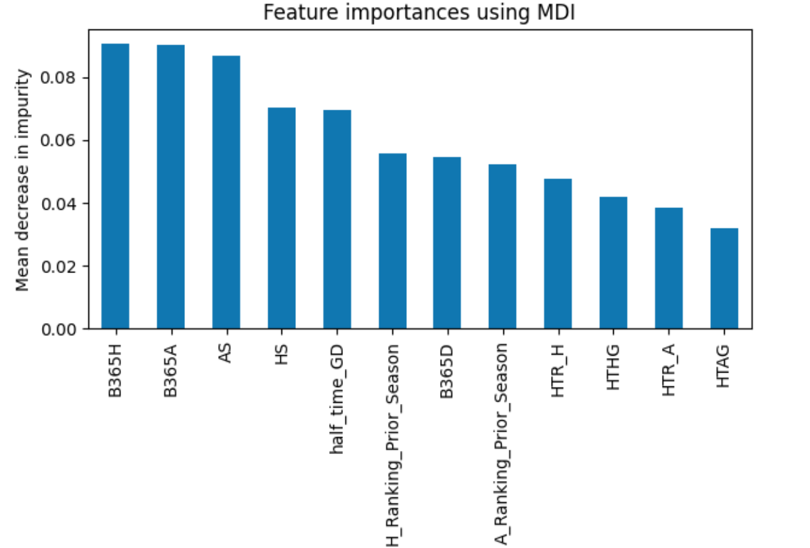
Results – Hypertuned Random Forest
Random forest accuracy on train set: 1.0
Random Forest accuracy on test set: 0.623
Hyperparameter tuning of the Random Forest:
We are tuning the minimum number of samples and the minimum number of trees that are required to yield the maximum accuracy
Maximum test accuracy: 0.649
Value of min samples that achieves max test accuracy: 0.001
Value of min trees that achieves max test accuracy: 201
Before undergoing the process of hyperparameter tuning, the accuracy that was output was 0.623, and after the process, the final test accuracy is 0.658.
Using random forest model, we can see and analyze which features were the more important in the prediction process
Presentation for SCH-MGMT690STG

Slide 15
Comparing the Models
Model | Accuracy
Baseline | 0.623
Decision Tree | 0.623
KNN | 0.632
Logistic Regression | 0.588
Random Forest | 0.658
As depicted in the table provided, the Random Forests model emerged as the most accurate predictor among the models evaluated. Compared to the baseline model, the Random Forests model exhibited a 3.5% increase in accuracy, highlighting its superior performance in predicting the outcomes of the Premier League matches.
Presentation for SCH-MGMT690STG

Slide 16
Conclusion
We have applied standard machine learning techniques to analyze the 2022/23 Premier League Season and thus create a model that can predict the outcome of the games that took place within the season.
Based on the results, we can successfully conclude that the Random Forests Model gives us the most accurate predictions.
Betting odds, Home shots and away shots are the important features to predict the outcome of the football game according to the model we developed.
Additional data we added to the table helped us to improve accuracy of the model.
Presentation for SCH-MGMT690STG

Slide 17
Why we deserve 110%
We ran 4 different models to compare with the baseline models.
Added Hyperparameter tuning to every model
Produced more accuracy by adding additional data.
Finally made a nice presentation to showcase everything we did.

